Slide 1
PROJECT NAME
BUILD A WEBSITE FOR ONLINE T-SHIRT SELLING
STUDENT INTERNSHIP
INTERN_DN17_19
MOCK PROJECT REPORT
TEAM MEMBERS:
NGUYỄN PHƯỚC VĨNH PHÚ
BÙI NAM GIANG
LÊ VĂN ĐẠI
THÁI THỊ NHƯ
TRẦN VĂN Ý

Slide 2
OVERVIEW
USING ...
GOALS
Get to know the real working environment
Improve hard and soft skills
Learn more about frameworks
TASKS
DATABASE
PROJECT
RESEACH
SCOPE
Organizations and companies working on selling T-shirt in VN
DEMO
SUMMARY
FEATURES
Basic: viewing, buying, selling
Users’ features: logging in, logging out, personal account, etc.
Management features

Slide 3
OVERVIEW
USING ...
PLATFORM
Environment: Java
IDE: Eclipse
Architectural pattern: MVC
TASKS
DATABASE
PROJECT
LANGUA-GES
Front-end: HTML, CSS, JS
Back-end: Java
DEMO
SUMMARY
FRAME-
WORKS
Spring Web MVC
Hibernate

Slide 4
OVERVIEW
USING ...
LEADER
Nguyễn Phước Vĩnh Phú
TASKS
PHU NPV
GIANG BN
DAI LV
DATABASE
Front-end
Database
Admin – Shirt Management
Shirt list (view)
User Management
Request Management
Support Management
Cart and bill management
Transaction history (feature)
PROJECT
DEMO
SUMMARY
NHU TT
Y TV
User registration
File upload
Logging in/out
Personal account management
Password handling

Slide 5
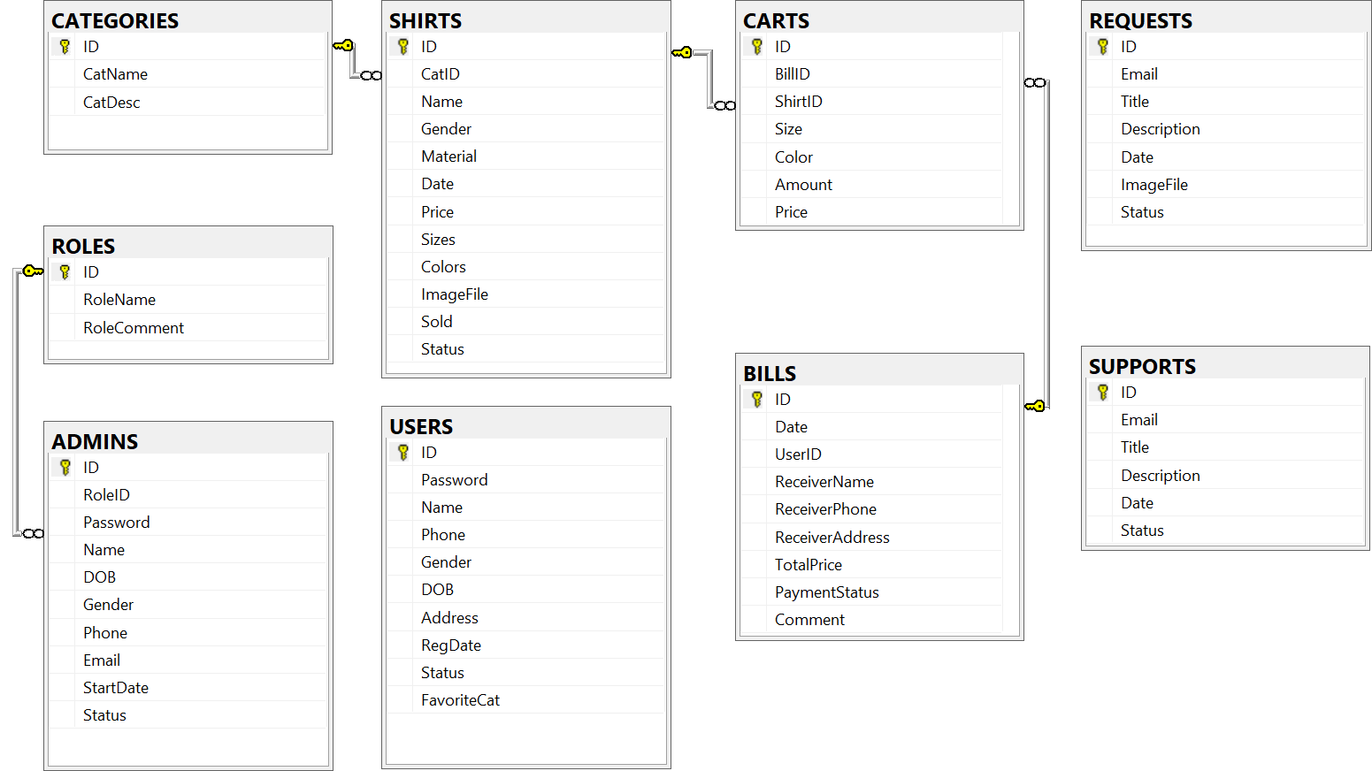
OVERVIEW
USING ...
TASKS
DATABASE
PROJECT
DEMO
SUMMARY

Slide 6
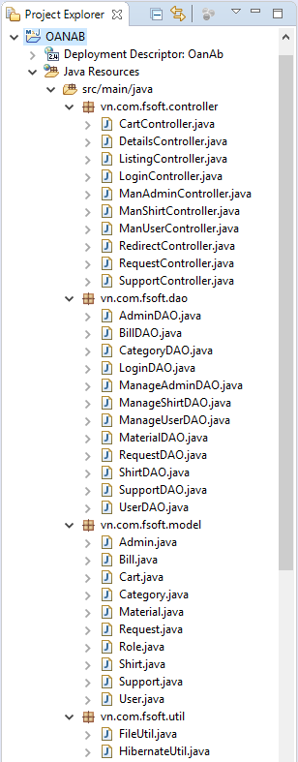
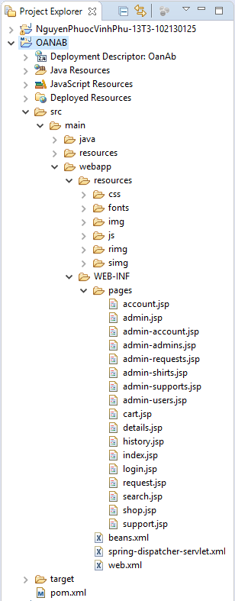
OVERVIEW
USING ...
TASKS
DATABASE
PROJECT
DEMO
SUMMARY

Slide 7




OVERVIEW
USING ...
TASKS
CONTROLLER
DATABASE
PROJECT
DEMO
VIEW
Model
SUMMARY

Slide 8
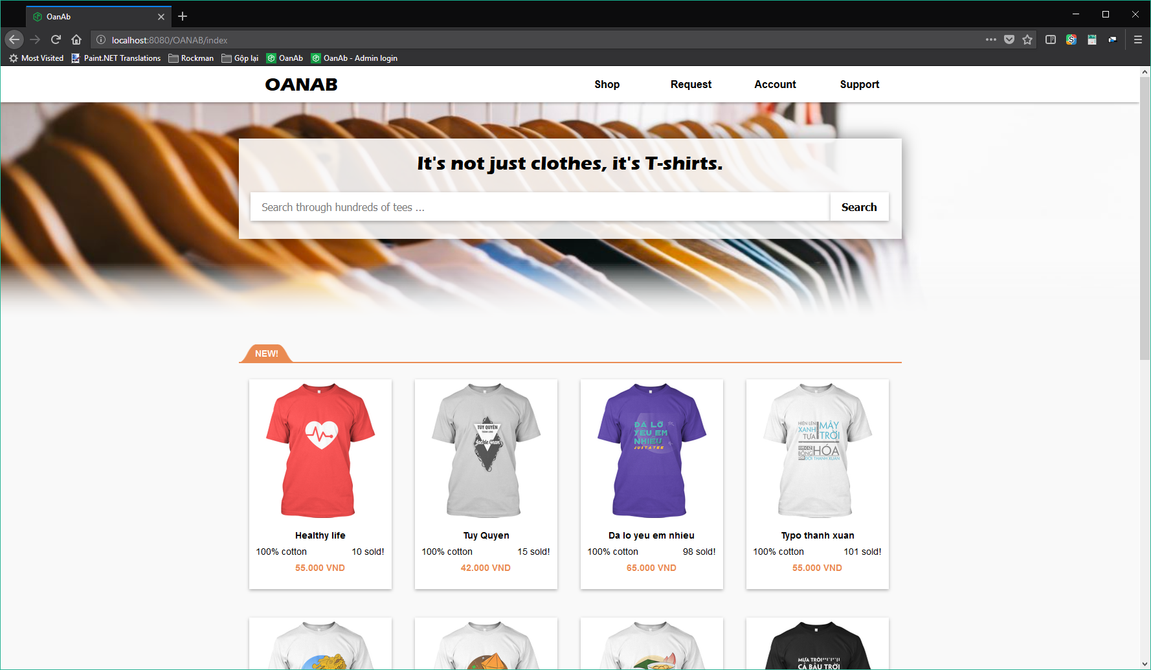
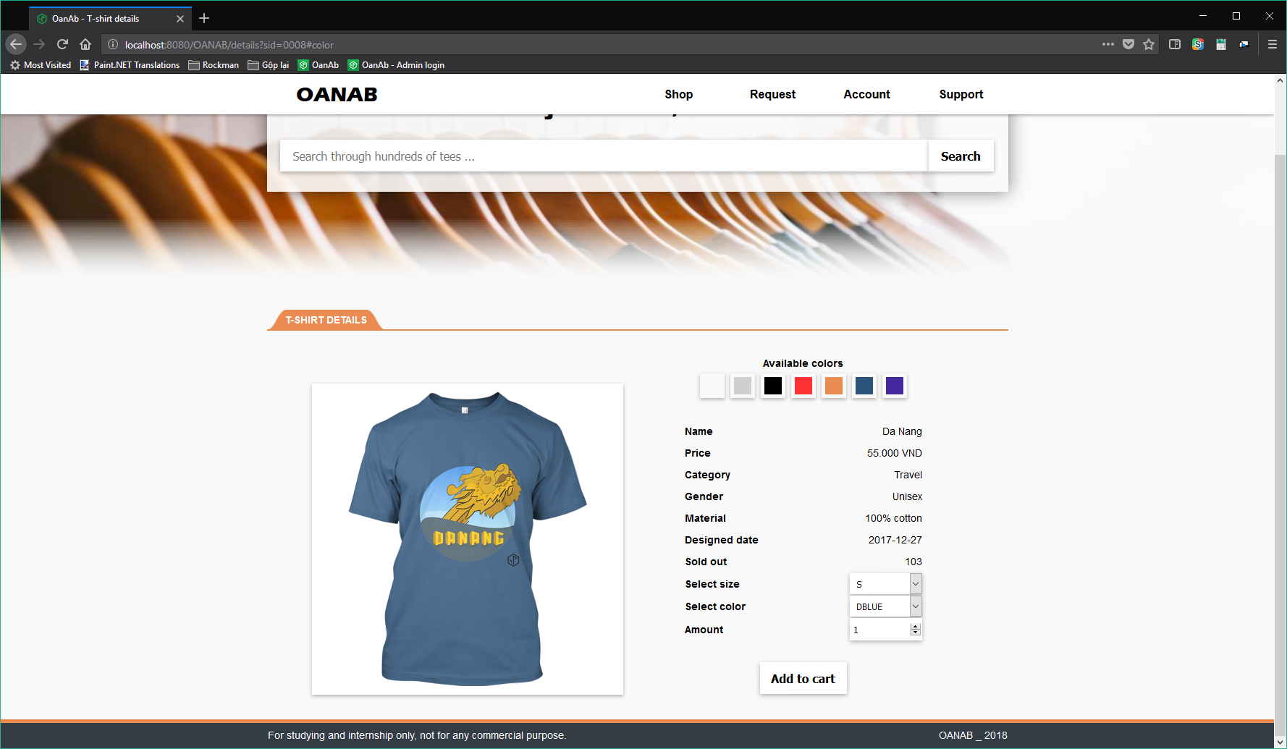
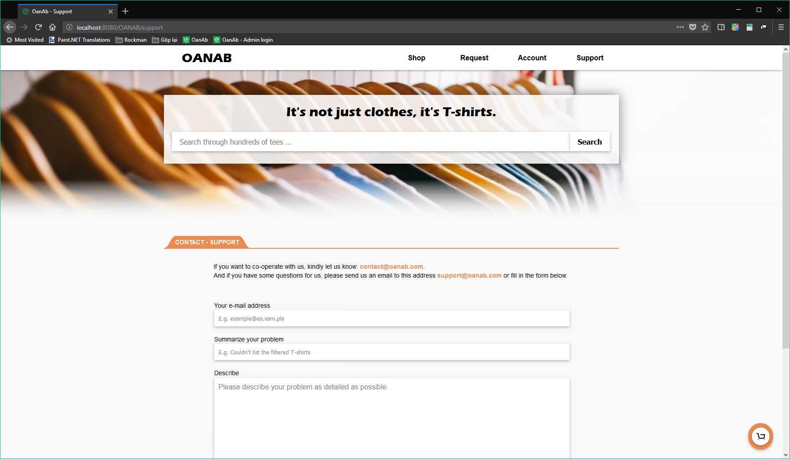
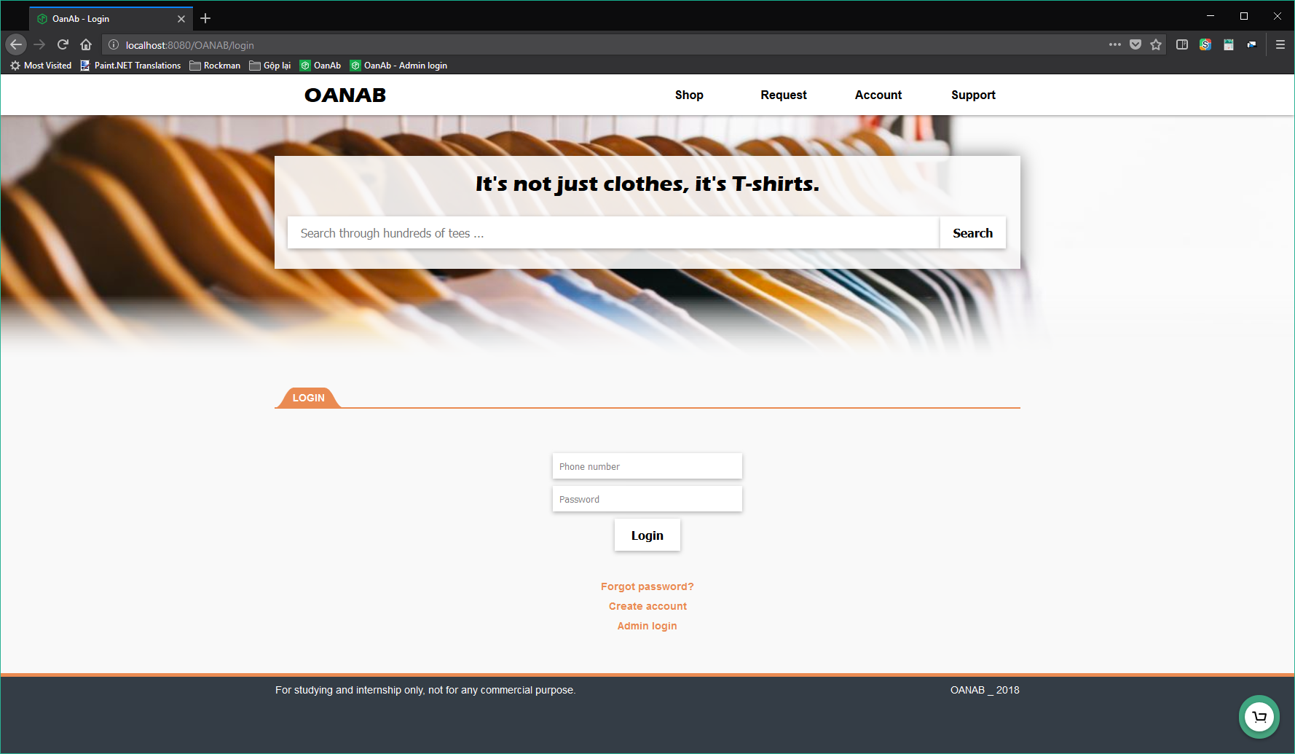
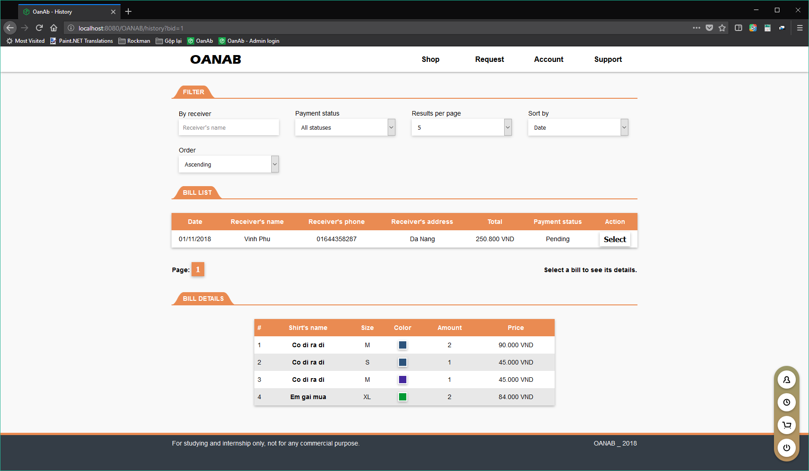
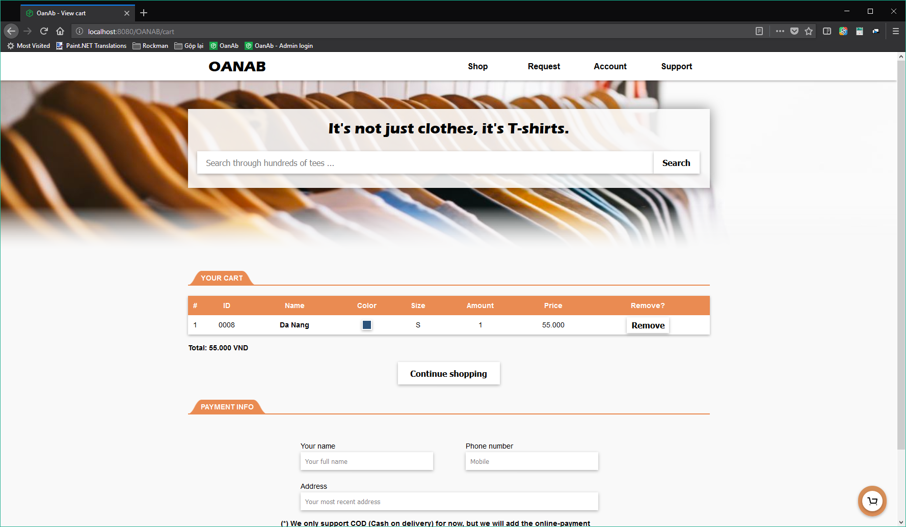
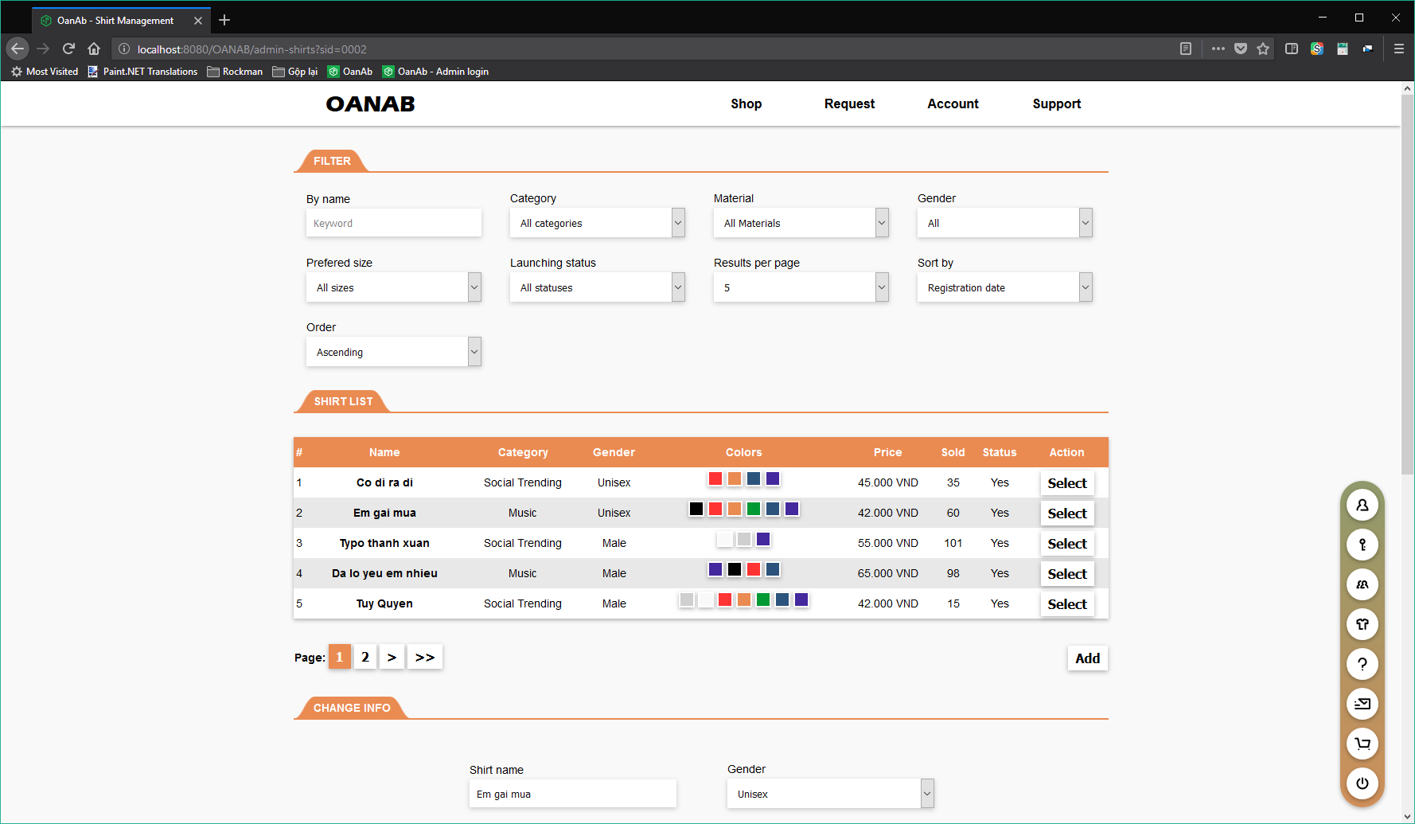
OVERVIEW
USING ...
SCREENSHOTS
Please see the application’s screenshots below
TASKS
DATABASE
PROJECT
DEMO
SUMMARY

Slide 9
OVERVIEW
USING ...
REAL RUN
We are going to see an app run. It won’t take so long.
TASKS
DATABASE
PROJECT
DEMO
SUMMARY

Slide 10
OVERVIEW
USING ...
RESULTS
Created a web application based on knowledge we have learnt
Finish the internship by getting through assignments and mock project
Improve ourselves
TASKS
DATABASE
PROJECT
GAINED
Learnt and got to use new technologies and knowledge
Gained and use necessary soft skills
Get familliar with new working environment
DEMO
SUMMARY
NEED IMPROVE-MENT
Using the required knowledge and technologies
Time management
Team work

Slide 11
WE WOULD LIKE TO THANK
FPT SOFTWARE
CSTC
AND HOPE TO SEE YOU SOON
CREDITS:
NGUYỄN PHƯỚC VĨNH PHÚ
BÙI NAM GIANG
LÊ VĂN ĐẠI
THÁI THỊ NHƯ
TRẦN VĂN Ý

